Slide 1
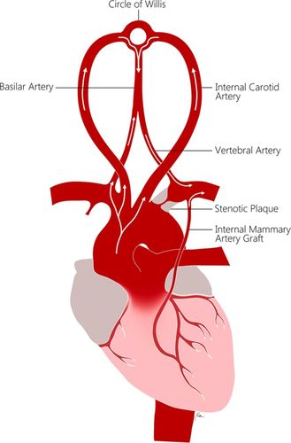
Primary Care Case Presentation
MEGAN MACKE RN, DNP-S
Jenna Herman
NUR 759 – Primary Care Clinical
Notes:
Image (Potter & Pinto, 2014)

Slide 2
Chief Complaint
Demographics: 64 year old male
Chief Complaint: In today with report of experiencing dizzy spells a handful of times over the past few months. Says potentially has been longer than that but along with dizzy spell he had about 2 weeks ago there was also accompanied feeling "my left leg gave out" and he had "swimming vision" as well as trouble with balance however was able to brace against a wall and symptoms resolved within a few seconds, no recurrence of all these symptoms together since. His dizzy spells are w/o any known trigger/cause, says they happen randomly and there is no specific time of day, not related to activity. Denies any new medications.
Otherwise he denies any intermittent claudication, upper or lower extremity pain, no ischemic pains, non-healing wounds. There has been no chest pain/pressure, abnormal heart palpitations, SOB/cough/wheeze/increased WOB, no LE edema.
He does note that since seeing Dr. Laclair in 2019 r/t renal disease/damage r/t prior lithium use, he has had some potential tingling in LUE noting that "it just feels funny" and there may have been some very slight weakness.
Had been monitoring bps and pulse after last dizzy spell with vision change and leg "giving out" a few weeks ago. Values have been consistently around 130s-140s/70s/80s in RUE and 100s/70s in LUE and reports a low SBP value in 90s with LUE.
Pertinent testing reported by patient: Noted in his hx with stress test complete April 2022, results showed nl stress testing but a consistent 30 point difference between R and L BP values.
Did have his recent CT of chest in March showing stable ascending aortic aneurysm and US done Dec. Prior showed similar results as well with abdominal aneurysm.
Notes:
Ex-wife is a nurse
Wanted to include some important tests in HPI rather than saying them later.

Slide 3
History
PMH: Hypothyroid, CKD from lithium use, asthma, glaucoma, arthritis, hypertension, hyperlipidemia, bipolar. (no pertinent surgical hx).
SH:Tobacco: Quit May 2019, 40 yr hx. Does not use chewing tobacco.
EtOH: None
Rec. drugs: Medical marijuana, vape or smoke, daily. Uses for neck and shoulder pain and sleep aid.
Exercise, not regular.
Family history: Stroke, epilepsy, arthritis, hypertension
Allergies: No known drug allergies, no known allergies
Medications: amlodipine 10mg, atorvastatin 20mg, buspirone 15mg, chlorthalidone 25mg, Lamictal 500mg, levothyroxine 150mcg, Seroquel 50mg PRN

Slide 4
Review of systems
General: denies fever, chills, or malaise. Feeling generally well.
Cardiac: Denies chest pain, palpitations, syncopal episodes.
Respiratory: denes shortness of breath of dyspnea on exertion
GI: denies constipation, diarrhea, or blood in stool.
GU: Denies urinary frequency, dysuria, or hematuria.
Neuro: Denies seizures or unexplained LOC, headache, difficulty hearing, tinnitus, difficulty with speech or swallowing, or problems with gait. Denies difficulty with thinking or memory, or depressive symptoms.
Notes:
So I did cover some of this in the HPI but just wanted to noted neuro specifc ROS.

Slide 5
Physical Exam
Vitals: Wt: 203.3 lb Ht: 69.5 in BMI: 29.6 BP: 142/86 Pulse: 68 RR: 16 Temp: 98.0F Sat: 98
General: Awake, alert and oriented. No acute distress. Well developed, hydrated and nourished. Appears stated age.
Eyes: Wears corrective lenses. Conjunctivae are clear without exudates or hemorrhage. Sclera is non-icteric. EOM are intact, PERRLA. No signs of nystagmus. Eyelids are normal in appearance without swelling or lesions.
Neck: The neck is supple without adenopathy. Trachea is midline. Thyroid gland is normal without masses.
Cardiac: No lifts, heaves, or thrills. PMI is not visible and is palpated in the 5th intercostal space at the midclavicular line. Heart rate and rhythm are normal. No murmurs, gallops, or rubs are auscultated. S1 and S2 are heard and are of normal intensity. Carotid pulse 2+ bilaterally with bruit auscultated on right and potentially on left but extremely faint if present. No JVD. Bilateral UE pulses wnl, cap refill <3 seconds but RBP 142/86 and LBP 106/86. Grip strength UEs wnl right, left barely discernible weakness but otherwise bilateral nl sensation/reflex. Bilateral LE w/o edema, cap refill <3 seconds, weak/thready 1+ DP/PT pulses, nl sensation/reflex/strength. RLE BP98/70, LLE BP 158/90.
Respiratory: No signs of respiratory distress. Lung sounds are clear in all lobes bilaterally without rales, ronchi, or wheezes. Resonance is normal upon percussion of all lung fields.
Abdominal: Abdomen is soft, symmetric, and non-tender without distention. Bowel sounds are present and normoactive in all four quadrants. No masses, hepatomegaly, or splenomegaly are noted. The aorta is midline without bruit or visible pulsation. Negative bilaterally for renal bruit.
Neurological: Normal speech. Cranial nerves II-XII intact. Cerebellar function is intact. Memory is normal and thought process is intact. No gait abnormalities are appreciated.
Notes:
I am going to jump to the cardiac section as other systems are unremarkable, noting especially the neuro aspect is unremarkable.
(had second DNP assess as well, he also noted R bruit and felt there could be faint left).

Slide 6
Management Plan
# Dizziness (R42) # Abnormal vision (H54.7) # Hyperlipidemia (E78.5) # Essential hypertension (I10) # Ex-smoker (Z87.891) # Aortic aneurysm (I71.9):
Discussed with HPI/PE concerning for potential s/s of stroke/TIA especially given reported family hx as well as his own personal comorbidities. Do feel concern for probably PVD to degree causing BP variations in limbs as well as LUE slight weakness and reported "tingling," also bruit(s) in carotids which are concerning again for stroke risk and potential cause for his described symptoms. Felt immediate concern r/t findings would be for potential stroke risk and findings in carotids, discussed schedule for bilateral US assessment to which he agreed. Further reviewed potential future w/u of PVD to include CT with runoff studies, pt wished to await carotid workup first, again I agree r/t immediate concern there. Further reviewed potential cause/augmentation r/t hx of aortic aneurysm which has been stable could also cause some symptoms at which point would require further workup and tx, but again starting with US of carotids since March CT showed aneurism to be stable. No changes to HTN tx at this time r/t variations in values assessed. Instructed to seek care in ER if any return of symptoms r/t concern for potential stroke, he indicates understanding, otherwise, await US of carotids and development in POC pending results.
Carotid ultrasound resulted in CTA order. CTA resulted in urgent referral to cardiovascular surgery in Great Falls. Patient was educated extensively over the follow-up phone calls on strict ER precautions.
#G45.8 Subclavian steal syndrome. #I65.09 Vertebral artery narrowing #I65.29 Internal carotid artery stenosis
Notes:
Lot of phone call follow-ups after original management plan and will go into diagnostics after this slide more
Original appt sept 1st, Sept 19th discussed US results with patient (patient was not contacted with results), 9/22 CTA ordered, 10/6 urgent referral to GF --- sx on 10/25

Slide 7
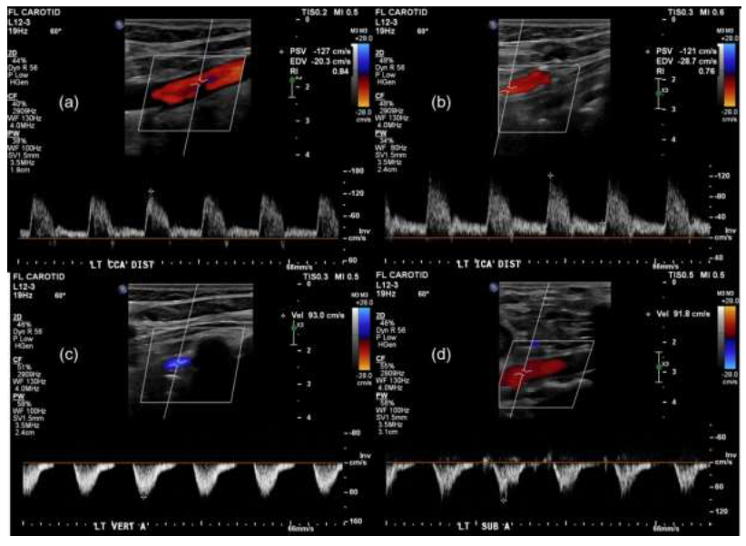
Diagnostics
Duplex Extracranial ultrasound- bilateral
BMP (BUN:28, Creatinine: 1.45, eGFR: 54) - - CTA
CTA results: approx 90% stenosis of left subclavian artery and a hypoplastic left vertebral artery originating distal to this high grade stenosis along with approx 70% stenosis of mid right ICA
Notes:
(Image (Bajaj et al., 2021)
****With further research to past medical history: patient had incidental finding of subclavian steal syndrome in 2019, patient was asymptomatic at this time however a CTA was recommended which the patient did not pursue. This information was found after the ultrasound. With ultrasound results a CTA was recommended again at this time which the patient agreed to. He is currently on HTN medication and statin which are recommended for subclavian steal along with anticoagulation which he does not want to pursue at this time.
Duplex ultrasound can suggest the presence of subclavian artery stenoses and demonstrate reversal of flow, if present, in the ipsilateral vertebral artery
When severe stenosis (>80 percent narrowing) of the proximal subclavian artery is present which in this patient it is, 65 percent of patients have permanent flow reversal in the ipsilateral vertebral artery, and 30 percent have intermittent flow reversal (Gomez, 2023)

Slide 8
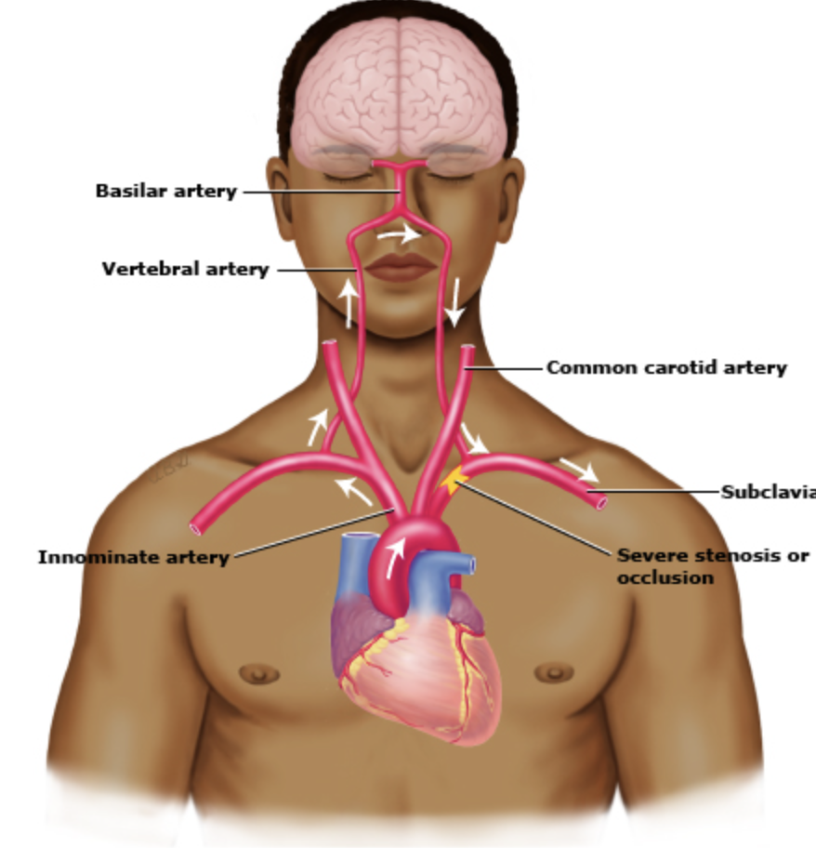
Pathophysiology- Subclavian Steal Syndrome
Subclavian steal steal syndrome is where there is an occlusion or significant stenosis proximal to the origin of the vertebral artery. This results in lower pressure in the distal subclavian artery resulting in additional blood being pulled from the cerebral circulation to perfuse the arm.
Etiology: atherosclerosis is most common
S/S: measurable BP differences between the upper extremities with episodic neuro symptoms like dizziness/vertigo/headaches. Patient may present with upper extremity ischemic symptoms.
Notes:
Image (Gomez, 2023)
**Note that blood flows up the contralateral vertebral artery to the basilar artery and then down the ipsilateral vertebral artery away from the brainstem.
**Low incidence of cerebrovascular symptoms (dizziness/vertigo, binocular double vision, incoordination, syncope, or drop attacks (sudden fall without loss of consciousness)- sometimes can be provoked by certain head movements like rotation toward the opposite side or extension when reaching for something on the top shelf, sometimes additionally having upper limb ischemia
More common is the differential in BP between the upper limbs– particularly >40mmhg – research shows it only has to be >15mmhg, but average is 36.9 (moderate stenosis)
*if episodes are provoked by arm exercise-increased suspicion along with ischemic arm symptoms.
Other etiologies: giant cell arteririts, arterial thoracic outlet syndrome, congenital anomalies, surgical repairs of coarctation of aorta or tetralogy of fallot.
Differentials: could be vertebrobasilar embolism but unlikely with the transient episodes of presentation
There are 3 diagnostic criteria that exemplify compromise of downstream flow including: Measurable reduction in the epsilateral brachial artery blood pressure
Reversal of the direction of blood flow in the ipsilateral vertebral artery
Neurologic symptoms referrable to the vertebrobasilar circulation that may be explained by the presence of the hemodynamic derangement. (Gomez, 2023)

Slide 9

Management Course to Date:
End result: Bilateral angioplasty and stent placement x2 for left subclavian artery occlusion (STEAL syndrome) and right ICA occlusion on 10/25.
Has been in for follow-up with PCP: Has been at home recovering but did recently shoot and process a deer on his own taking him 12 hours noting it was usually a 3 hour ordeal in the past. He was started on Clopidogrel after procedure and feels he has had nausea often since starting use as well as a generalized fatigue. Says he expected "more gas in the tank" after surgery but has not felt he is bouncing back as fast as he would like noting he wished to be out elk hunting but does not have the energy for this.
Physical exam: L arm BP 138/90; R arm BP 134/82
Plan: patient has not followed up cardiovascular surgery as he was upset with the process of getting in/out of the hospital and when they called he did not answer. Recommended that he follow-up with the cardiac surgeon to establish how long they want him to be on clopidogrel for. Encouraged him to continue taking, but take with food to help with nausea.
Notes:
Physical Examination: Wt: 202 lb Ht/Ln: 69.5 in BMI: 29.4 BP: 134/82 Pulse: 68 RR: 16 Temp: 97.8F Sat: 96
****Lifestyle changes for secondary prevention of restenosis, and antithrombotic therapy to prevent restenosis. Clopidogrel and aspirin is used for a period of 6-12 months and then a single antiplatelet agent is usually appropriate- could be aspirin.
CV: No lifts, heaves, or thrills. PMI is not visible and is palpated in the 5th intercostal space at the midclavicular line. Heart rate and rhythm are normal. No murmurs, gallops, or rubs are auscultated. S1 and S2 are heard and are of normal intensity. Carotid pulse 2+ bilaterally without bruit. No JVD. No LE edema. There is x1 groin access sight in right groin space with scattered ecchymosis in various stages of healing, no s/s of infection. Left arm BP 138/90, right 134/82. Right arm has x1 <1cm fluctuant mobile mass mildly tender to palpation located in region of proximal brachialis on dorsal aspect of forearm and is w/o surrounding/underlying skin/tissue changes/abnormalities or s/s of infection. Was unable to appreciate any soft tissue/bony abnormality from base of occiput down into right arm/hand and CSMs wnl.

Slide 10
Summary
Most patients are asymptomatic
Most common symptoms if they do occur are headaches and dizziness, along with a significant difference in BPs on upper extremities.
Conservative management is usually preferred due to a low risk of ischemic stroke; management of hypertension, hyperlipidemia, and possible antiplatelet agents.
Intervention for subclavian steal syndrome depends on underlying etiology and location of blockage. If symptoms of vertebrobasilar ischemia- intervention is necessary. 5% of patients require angioplasty, with 10% chance of requiring repeat angioplasty later in life.

Slide 11

Discussion
Because the BP can be so significantly different per arm, how do you think that BP management should be handled?
Pt is difficult regarding compliance, is there anything you guys would you have done differently?
Looking back, we could have specifically asked about arm exercise provoking symptoms. Anything else?
Notes:
All that I could find on BP management was that aspirin, beta blockers and ACE inhibitors are the specific choice for HTN management. The ipsilateral brachial artery will how sporadically low blood pressure readings (Song et al., 2021). Pay attention to increase in magnitude or duration of original symptoms. If blood pressure cannot be managed this would be an indication for intervention (Gomez, 2023).
Radial pulses, skin (skin and nail beds of affected extremity should be examined for embolism.)
I also want to note that many of the research articles I read make note the importance of thorough history taking as these can be generalized symptoms for a lot of different reasons. Measurement of blood pressure in both arms differential, examination of the neck and chest is essential in the initial evaluation of patients presenting with upper extremity ischemic symptoms or neurological symptoms including syncope, dizziness, ataxia, or vertigo (Kikkeri & Nagalli, 2023).
PE: All major pulses should be palpated, and blood pressure should be checked in both arms. Bruits may originate from the anterior (carotid) or posterior (subclavian/vertebral) circulation (Gomez, 2023).

Slide 12
References:
Bajaj, S., Sharma, P., & Bhatia, U. (2021). Subclavian steal syndrome: an underrecognized manifestation of atherosclerosis – review of current literature with a case report. Journal of Radiology and Clinical Imaging. https://fortuneonline.org/articles/subclavian-steal-syndrome-an-underrecognized-manifestation-of-atherosclerosis--review-of-the-current-literature-with-a-case-report.html
Gomez, C. (2023). Subclavian steal syndrome. UpToDate. https://www.uptodate.com/contents/subclavian-steal-syndrome?search=subclavian%20steal&source=search_result&selectedTitle=1~16&usage_type=default&display_rank=1
Kikkeri, N. S., & Nagalli, S. (2023). Subclavian steal syndrome. National Library of Medicine. https://www.ncbi.nlm.nih.gov/books/NBK554599/#:~:text=The%20pathophysiology%20involves%20blood%20flow,direction%20of%20the%20affected%20side.
Potter, B. & Pinto, D. (2014). Subclavian steal syndrome. Circulation AHA Journal, 129 (22). https://www.ahajournals.org/doi/10.1161/CIRCULATIONAHA.113.006653
Song, D., Ireifej, B., Seen, T., Almas, T., Sattar, Y., & Chadi Alraies, M. (2021). Diagnosis and management of unilateral subclavian steal syndrome with bilateral carotid artery stenosis. Annals of Medicine and Surgery (2012), 68, 102597. https://doi-org.ezproxy.umary.edu/10.1016/j.amsu.2021.10259
Uematsu, H., Noguchi, Y., & Osugi, Y. (2023). Point-of-care ultrasonography in the diagnosis of subclavian steal syndrome. BMJ Case Reports, 16(4). https://doi-org.ezproxy.umary.edu/10.1136/bcr-2022-254477
Woo, J. D., & Markowitz, J. E. (2022). A Great Heist: Subclavian Steal Syndrome Causing Posterior Transient Ischemic Attack and Stroke. The Permanente Journal, 26(4), 106–109. https://doi-org.ezproxy.umary.edu/10.7812/TPP/21.234

